Slide 1
Neural Message Passing for Visual Relationship Detection
汇报者：潘文彬
20210240244
Presented at the ICML 2019 Workshop on Learning and Reasoning
with Graph-Structured Data Copyright 2019 by the author(s).

Slide 2
PART 01
Introduction

Slide 3
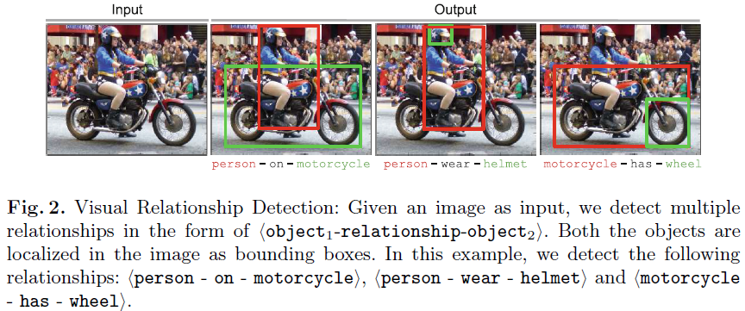
Visual relationship detection

Slide 4
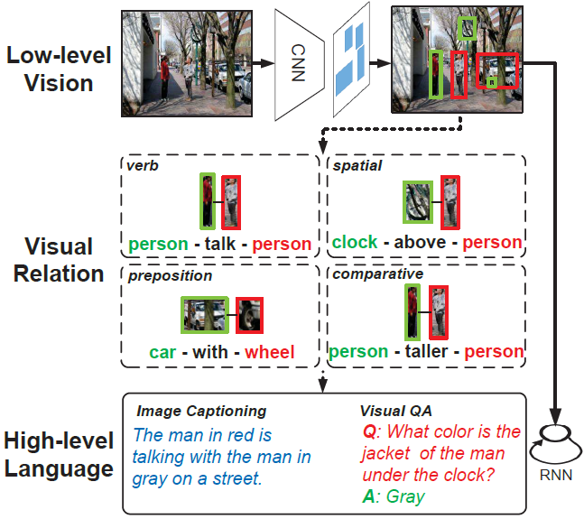
Visual relationship detection

Slide 5
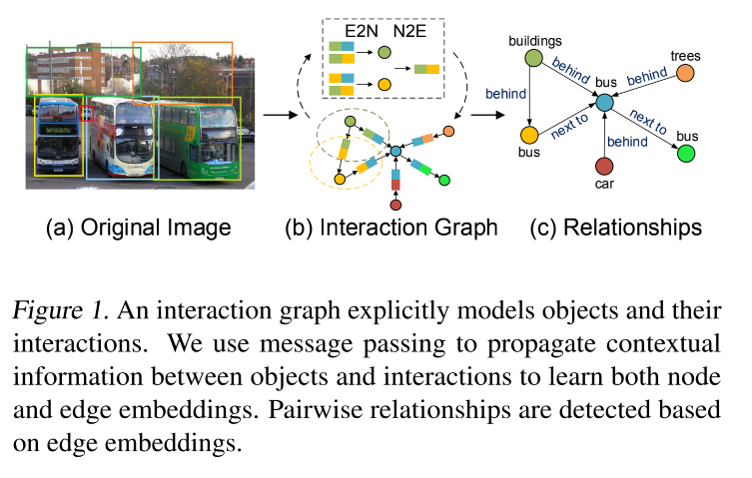
Interaction graph

Slide 6
Main contributionls
We propose a novel graph-based method to explicitly
model interactions between objects in an image and use a
message-passing-style algorithm to capture high-order in_x0002_teractions.
We introduce the word embedding of each object and
the relative spatial location between pairwise objects as the complement to the visual appearance.
The proposed method consistently outperforms the previous state-of-the-art methods on two widely used datasets.

Slide 7
PART 02
Related Work

Slide 8
Visual relationship detection
At the very beginning, a unique class to each relationship triplet is assigned; however, with the increase of objects and predicates, the amount of relationship triplets is explosive.
To reduce the complexity, objects and predicates are learnt separately; however, the separate model results in the lack of context between the related components.
To address this, feature sharing by message passing between the three components are encouraged. Furthermore, the global contexts are introduced by utilizing graph. Interactions based on the semantic-action graph of the entire training set is sequentially predicted . Object embeddings by aggregating the visual appearance of the surroundings in the visual graph is enhanced. However, the interaction embedding was ignored in the previous works.
Instead, we explicitly model both interaction and object embeddings in the interaction graph. Language priors and spatial cues are further introduced to improve the performance in. In this work, we integrate the word embeddings and spatial location to help estimate relationship.

Slide 9
Graph neural networks
Graph neural networks recently have got a lot of attention and achieved significant success in various fields, especially in social networks, knowledge graphs and human object interaction.
In this work, we apply graph neural networks to the application of visual relationship detection.

Slide 10
PART 03
Methodology

Slide 11
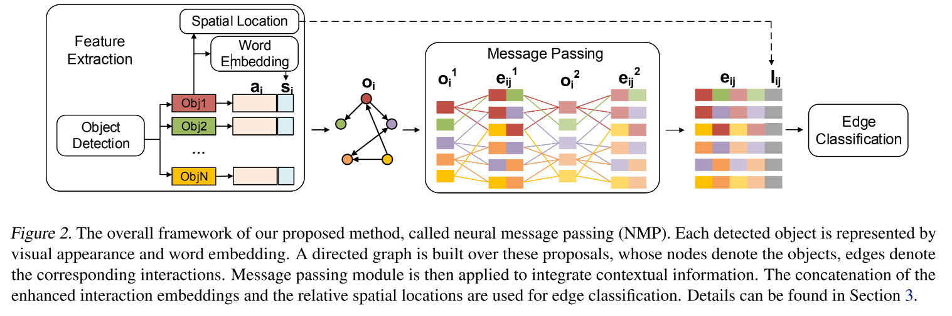
Overview

Slide 12
Feature Extraction
The functionality of this module is to get the visual and semantic cues of the objects and the relative spatial locations between pairwise objects.
The i-th object in the image is associated with a bounding box bi = {xi; yi; wi; si} and a category ci.
To extract deep visual features of an object, we adopt VGG16. The resulting features form the visual embedding ai.To complement the visual information, we use the pre-trained word2vector to map the object category ci into word embedding si. The object embedding of the i-th object oi = [ai; si].
As for the spatial information, we adopt the idea of box regression and use box delta to get the box differences.Furthermore, we use intersection over union (iou) and normalized distance between two objects.

Slide 13

Graph Construction
The interaction graph contains a node set V and an edge set E. Each node vi ∈ V represents an object, which is composed of a bounding box bi, a corresponding object category ci and the original embedding oi.
Each edge eij ∈ E denotes the predicate between node vi and vj .
The edge exists when the connected objects are paired.

Slide 14
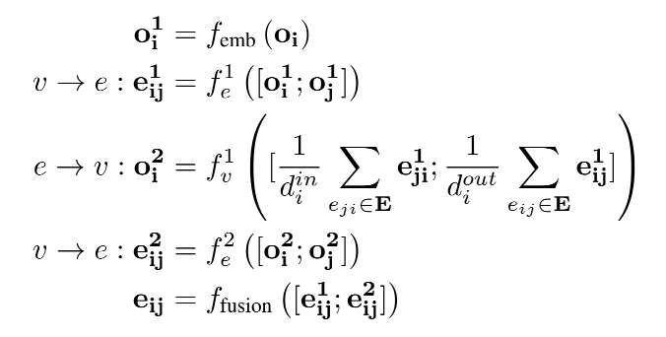
Neural Message Passing
The functionality of the message passing module is to improve interaction embeddings by aggregating global context cues.
In the node-to-edge phase,each edge receives messages from the connected nodes. In the edge-to-node phase, the node embedding is updated according to the linked edge embeddings.
The functions f1e , f1v , f2e are neural networks used for mapping between node and edge embeddings. In our experiments, we adopt two-layers fully-connected networks
(MLPs) with Elu activation function.

Slide 15
Edge Classification
The functionality of this module is to classify the interactions between objects.
The interaction embedding is the concatenation of the final edge embedding and spatial location; that is, xi,j = [eij; lij].
Then, the confidence of the predicate category between the i-th and the j-th objects is yij = softmax (Wxi,j), where W is the embedding matrix that maps interaction embeddings to match predicate categories.
In our experiment, we use multi-class cross entropy loss for classification.

Slide 16
PART 04
Experiments

Slide 17
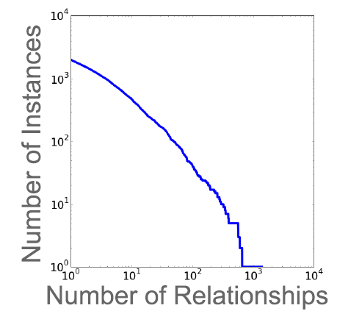
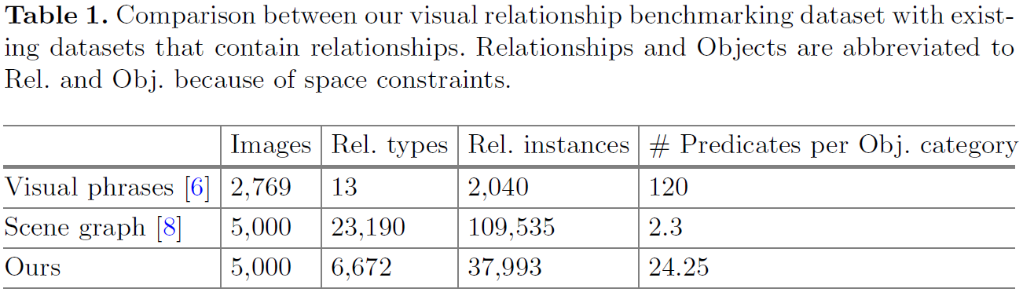
Datasets
Visual Relationship Detection (VRD) contains 5,000 images with 100 object categories and 70 predicate categories.
There are 1,877 relationship triplets only exist in the test set, which is used for zero_x0002_shot evaluation.
Visual Gnome (VG) contains 99,658 images with 200 object categories and 100 predicates.

Slide 18
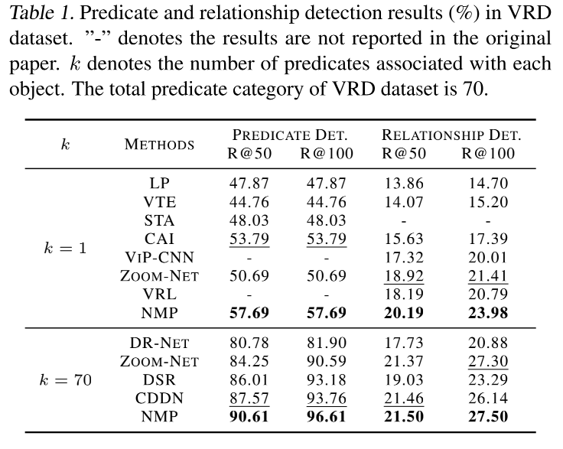
Evaluation Metrics
We use Recall@50 (R@50) and Recall@100 (R@100) as the evaluation metrics.
R@n computes the fraction of true positive predicted relationships over the total annotated relationships among the top n confident predictions.
Let k be the number of predicates associated with each object. We report R@n under various k values.

Slide 19
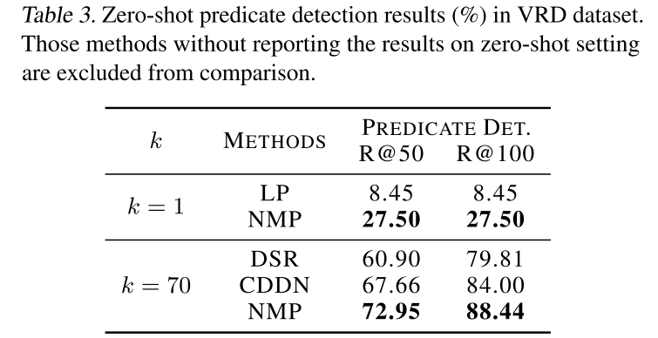
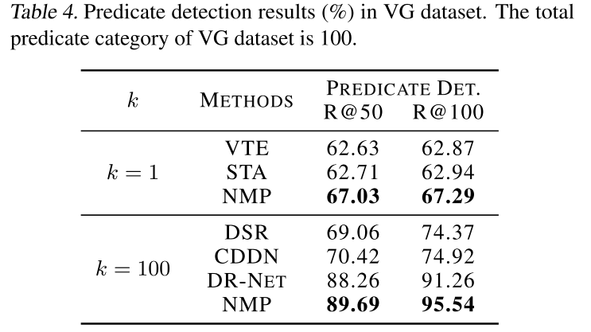
Compared with State-of-the-art Methods

Slide 20
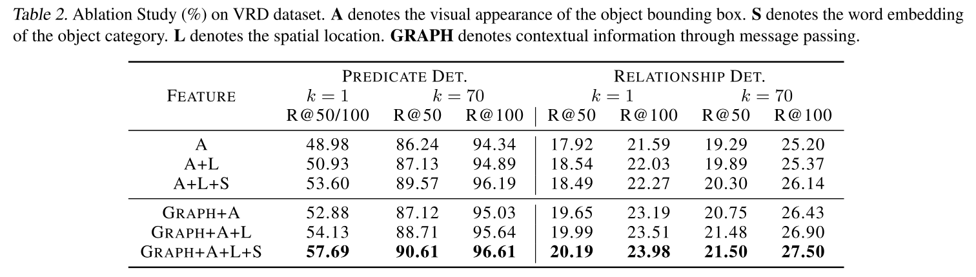
Ablation Study
We see that the spatial location and the word embedding improve the performance by around 1% and 3% respectively on predicate detection.
Because the spatial information is not easy to learn from the visual appearance, and language priors can help rule out some obviously unreasonable compositions.
Message passing (GRAPH) improves the recall stably by around 3%, 2% on predicate and relationship detection respectively.

Slide 21
PART 05
Conclusion

Slide 22
Conclusions
In this paper, we address the lack of context between interactions in previous works.
We construct an interaction graph with a message-passing mechanism to explore high-order interactions.
Besides, we use visual appearance, language priors, and spatial cues to complement each other.
Experimental results show that our proposed method outperforms
the state-of-the-art methods on two benchmark datasets.

Slide 23
Thanks！

